Slide 1
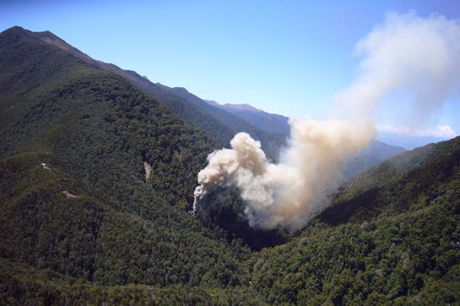
Mine Fire and Explosion Seminar Capella – 27th March 2014

Slide 2
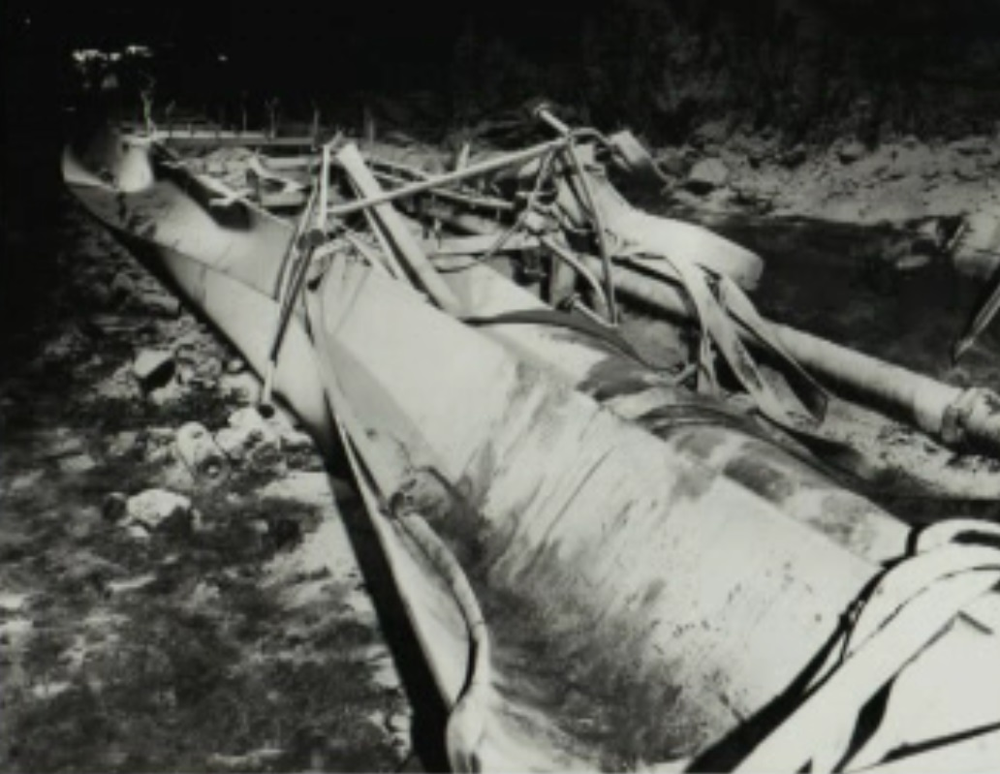
Moura #4 16th July 1986 12 Men Killed.

Slide 3
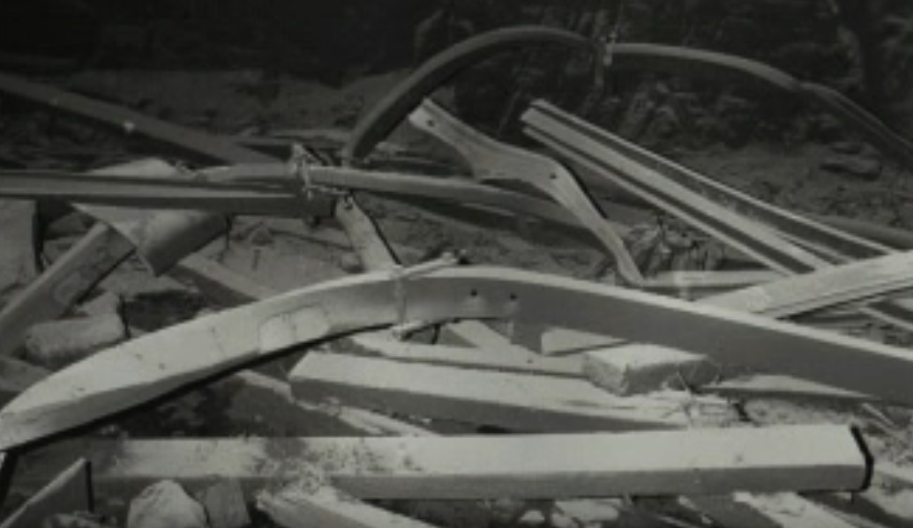
Moura #4
Pillar Extraction in Main Dips
60m of massive sandstone roof
Fairly gassy (7m3/t – BUT 7 m thick)
Roof fall - CH4 into workings
8 possible ignition sources
Flame safety lamp most likely

Slide 4
Moura #4
8 men escaped from UG.
Assumed a fall (expected)
Men sent underground
Inspector found CO at fan

Slide 5
Moura #4
All men withdrawn
Rescue teams re-entered 36 hrs later.
Found a orderly withdrawal
Young miner under SC.
Subsequent fire required inertisation.

Slide 6
Moura #4
Faulty and gassy area.
Swillies due to faults
Up to May 86 no surface subsidence due to land ownership.
30th June 86 full extraction commenced.
Inspector concerned about mining practices of 1 crew.
Failure to follow the extraction plan

Slide 7
Moura #4
Heavy weight observed on 15th of July.
No unusual CH4 detected.
11:05 Explosion
Dust cloud around fan

Slide 8
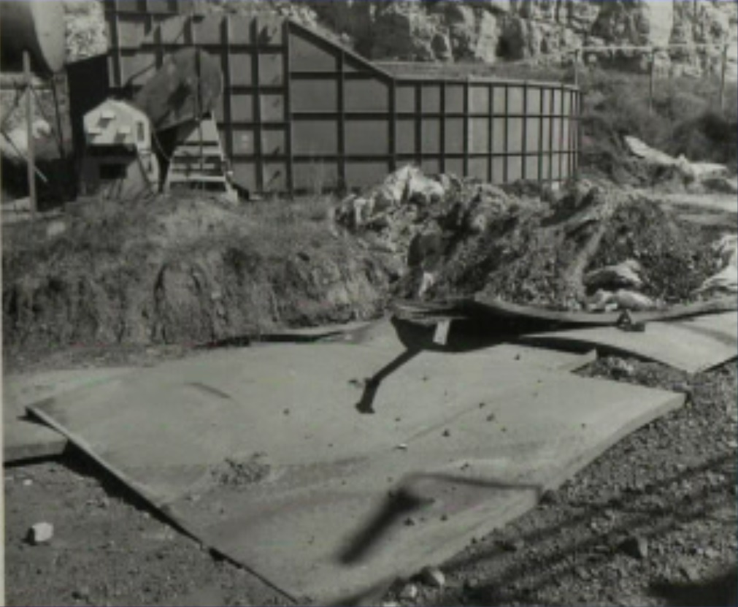
Moura #4
Substantial damage to fan duct
Internal baffles blown 25 m.
Manager on holidays.
For over an hour after explosion it was assumed it was still a goaf fall.
Inspector recognised CO poisoning during debrief.
700 ppm CO detected at fan.

Slide 9
Moura #4
1:07 pm 700 ppm CO 2.2% CH4 at Taj Mahal – destroyed.
After debrief of MR teams identified explosion.
Rescue suspended until gas analysis.
IR analyser from MR

Slide 10
Moura #4
Off scale CO at portal +5000ppm.
After GC arrived and explosion risk assessed, men re-entered.
Fire identified and recovery suspended.
Didn’t want to flood area. Had to get the MineShield from NSW

Slide 11
Moura #4
Enough N2 but no Propane
Direct injection froze ground
Gas results OK, UG inspection detected a fire.
Men recovered with aid of inertisation.

Slide 12
Findings
Stonedusting, water barrier and swilly probably saved the lives of others in the mine.
Compressed air hoses at face were not AS.

Slide 13
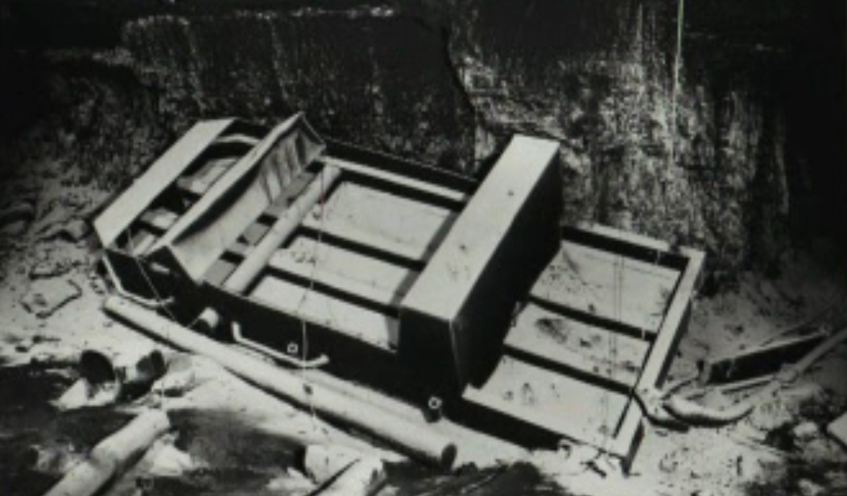
Emergency MGT
No Structure established
No line of command
No system of briefing officials
No recording of information obtained

Slide 14
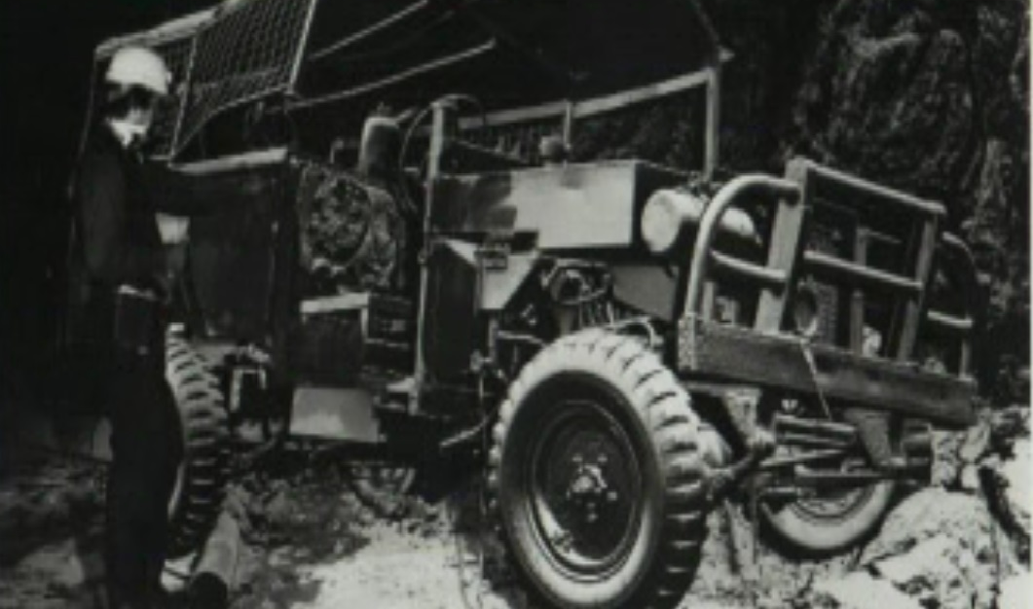
Recommendations
Flame Lamps prohibited.
Frictional ignition research and other ignition sources.
Training, including Induction Training, Refresher Training and an exam to be experienced
Training in explosions.

Slide 15
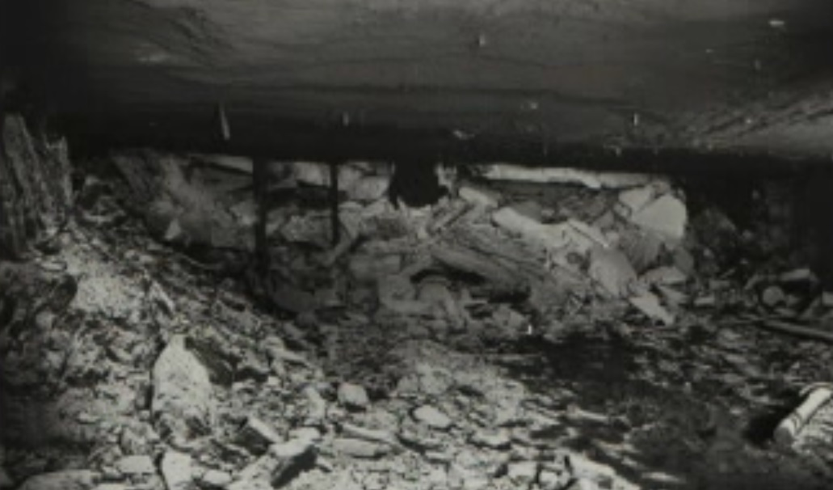
Recommendations
Development of Emergency Procedures.
Up to date list of experts maintained by DME.
Availability of Chromatograph to detect hydrogen content
SIMTARS autonomy
Inertisation

Slide 16
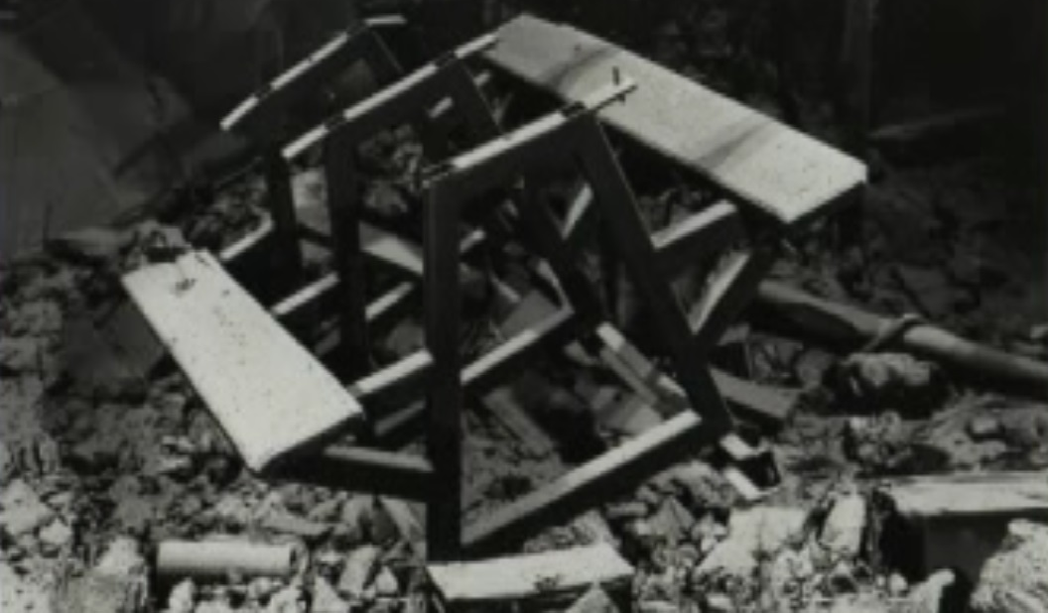
Recommendations
Enforcement of Aluminium Alloys.
Continuous gas monitoring.
Approved Scheme for extraction
Monitor overseas developments

Slide 17
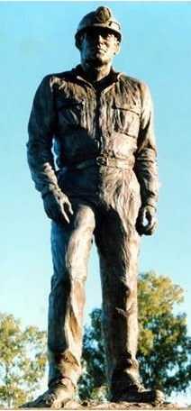
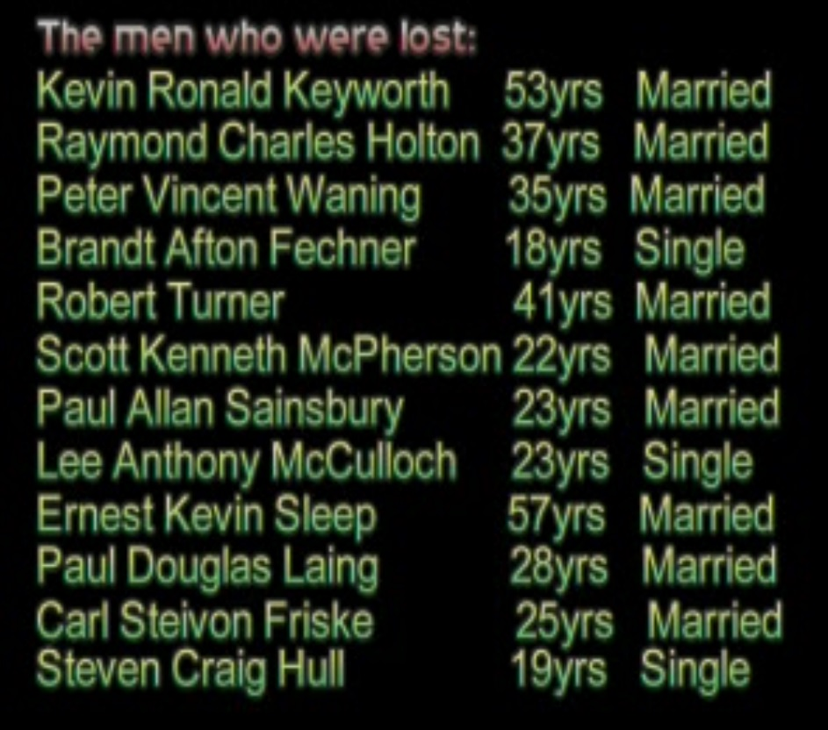
Memorial

