Slide 1
Hillcrest Mine Disaster June 19, 1914

Slide 2
Hillcrest Mine Disaster 100 Year Anniversary
Celebrating the Spirit of the Miner
www.hillcrestmine100.com

Slide 3
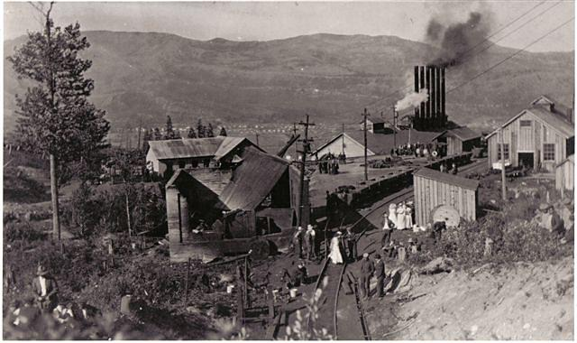
On June 19, 1914
250 miners go to work,
of the 235 underground only 46 survive

Slide 4
Hillcrest Mine Disaster 100 Year Anniversary
Most of the victims are buried in mass graves in Hillcrest Cemetery
The remainder are buried back in their home towns

Slide 5
Hillcrest Mine Disaster 100 Year Anniversary
Hillcrest Cemetery declared a Provincial Historic Resource in 1985
Featured attraction on Crowsnest Heritage Route with thousands of visitors annually
Continued restoration projects span decades

Slide 6
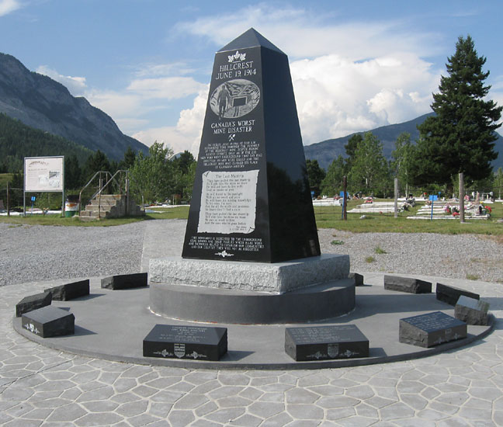
Hillcrest Mine Disaster 100 Year Anniversary
Monument to Hillcrest Mine Disaster - 2000

Slide 7
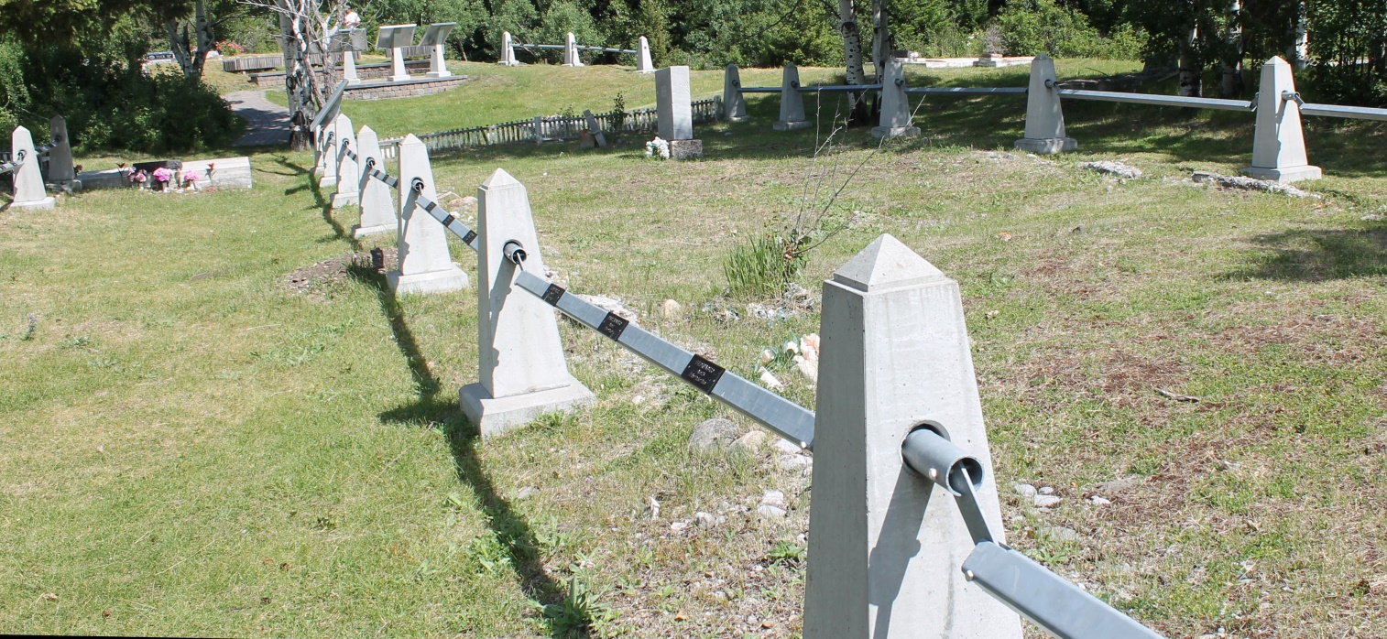
Hillcrest Mine Disaster 100 Year Anniversary
90th Anniversary in 2004 - placement of a perimeter fence with special grave markers

Slide 8
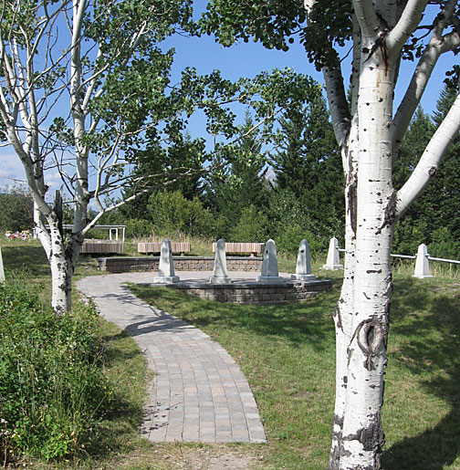
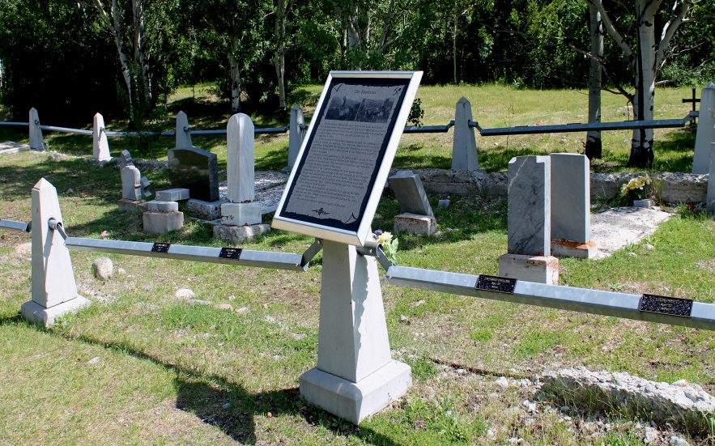
Hillcrest Mine Disaster 100 Year Anniversary
2007 - Installation of interpretive signs and interpretive overview

Slide 9
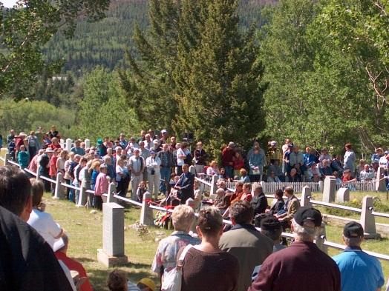
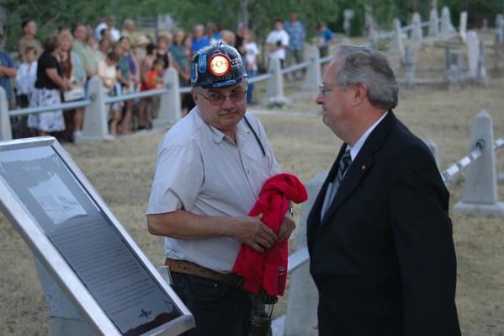
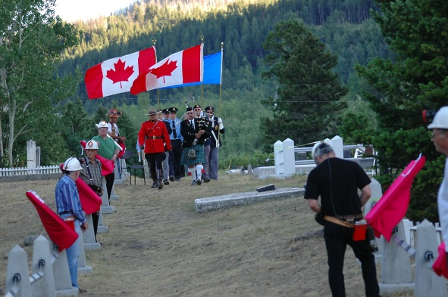
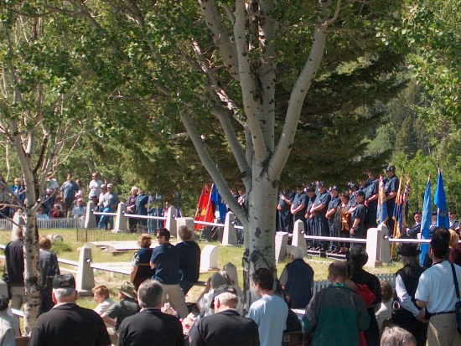
Hillcrest Mine Disaster 100 Year Anniversary
2010 Final placement of signs and Commemoration and Dedication

Slide 10
Hillcrest Mine Disaster 100 Year Anniversary
100th Anniversary
Commemorative Restoration Project
A new entrance feature to the cemetery that will appropriately identify and honour for visitors the significance of the Hillcrest Mine Disaster

Slide 11
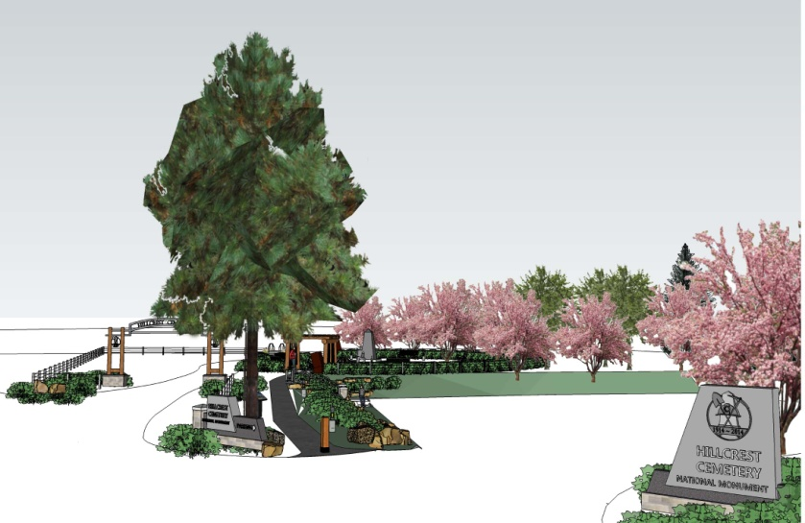
Hillcrest Mine Disaster 100 Year Anniversary
Entrance Improvements

Slide 12
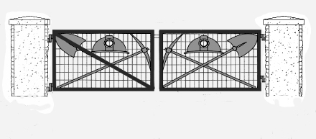
Hillcrest Mine Disaster 100 Year Anniversary
Service gates

Slide 13
Hillcrest Mine Disaster 100 Year Anniversary
Hillcrest Mine Disaster Memorial Committee working in association with the Crowsnest Heritage Initiative & the Crowsnest Community Foundation to complete project
Project budget of $ 350,000 - to be achieved through grants and sponsorship
Charitable tax receipts issued on donations

Slide 14
Hillcrest Mine Disaster 100 Year Anniversary
100th Anniversary Weekend
June 19-21, 2014
Save the Date

Slide 15
Hillcrest Mine Disaster 100 Year Anniversary
Commemoration Ceremony
Thursday, June 19th
Funeral Procession Re-enactment
Graveside Service
Evening Concert

Slide 16
Hillcrest Mine Disaster 100 Year Anniversary
Celebrating the Spirit of the Miner Friday, June 20th
Showcase Crowsnest Pass;
Frank Slide Interpretive Centre
Bellevue Underground Mine
Crowsnest Museum
Crowsnest Pass Art Gallery
Evening – Miners Picnic and Outdoor Dance
Live music – Coal Creek Boys, beer gardens, barbeque

Slide 17
Hillcrest Mine Disaster 100 Year Anniversary
Celebrating the Spirit of the Miner
Saturday, June 21st
Bellecrest Days events – Hillcrest
Pancake breakfast, parade, wagon rides, heavy horse pull, guided hikes to Hillcrest mine site
Hillcrest Miners Club featuring Maria Dunn
Evening events - Museum event - live music

Slide 18
Hillcrest Mine Disaster 100 Year Anniversary
Promotional Activities
Invitations
Guest Services
Commemorative brochure
Hillcrest Mine Disaster book
Media coverage
Travel and Tourism

Slide 19
Hillcrest Mine Disaster 100 Year Anniversary
Company’s coming!
Spring Cleaning & Community Pride
Landscaping around cemetery site
Spruce up the main streets in Hillcrest
Crowsnest Pass business participation & promotion

Slide 20
Hillcrest Mine Disaster 100 Year Anniversary
Get Involved!
Committees
Gifts in kind
Corporate engagement
Sponsorship of events
Sponsorship of capital project

Slide 21
Hillcrest Mine Disaster 100 Year Anniversary
Celebrating the Spirit of the Miner
www.hillcrestmine100.com

