Slide 1
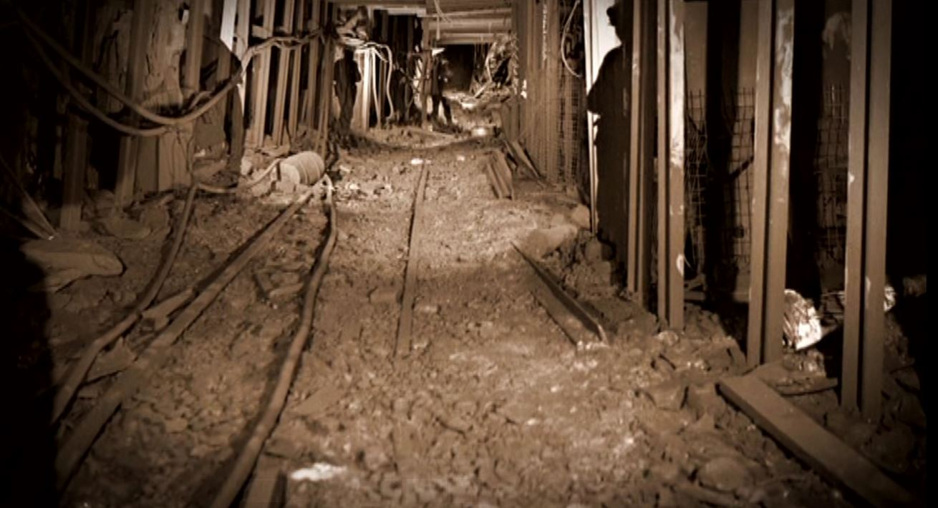
Appin Mine Explosion
Training Presentation
Acknowledgements – Bob Kininmonth (Retired Inspector)
Duncan Chalmers – (UNSW)
SMRS

Slide 2
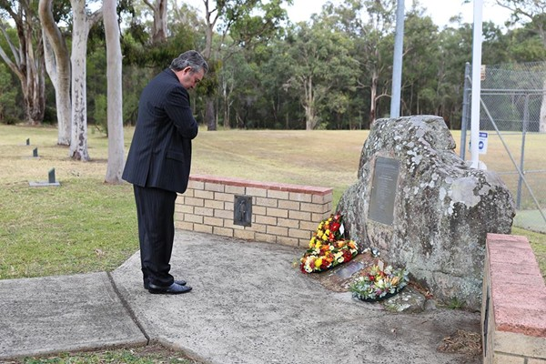
Background
At 11pm on Tuesday 24th July 1979 an explosion of methane gas in K Panel of Appin Colliery resulted in the deaths of 14 workers
This disaster was associated with a changeover of ventilation that was intended to create a situation whereby a central intake, in a three heading development panel, would be shielded from intake gas by returns on each side.
Prior to the changeover the panel had two intakes and one return.

Slide 3
Gas accumulation
The Bulli seam at Appin Colliery has a moderately high methane content.
Gas desorbs from the coal once the pore pressure within the coal is lowered to atmospheric pressure and the rate at which the gas comes out is very much dependent on the permeability of the coal itself.
This means that if a place is left unventilated then the gas issuing from the coal will mix with the air in the heading and the percentage will slowly rise.

Slide 4
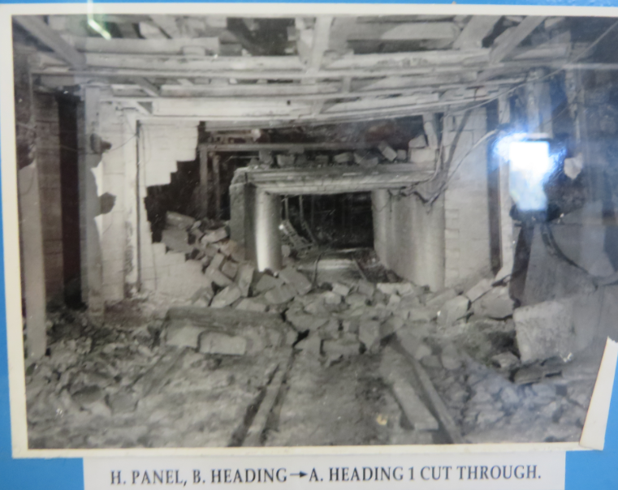
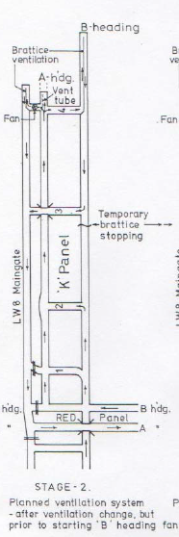
There are many scenarios that can be read into this particular event, however for an explosion to occur three things must be present, an ignition source, fuel and oxygen.
If the fuel is controlled then an explosion cannot ensue.

Slide 5
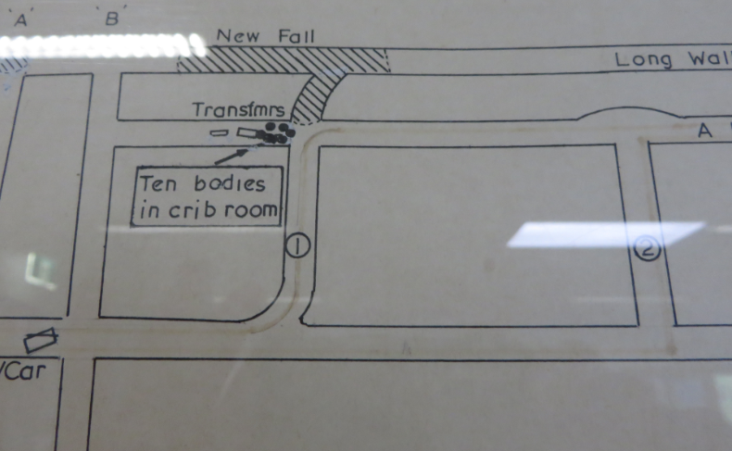
Established Information
At the time of the explosion ten of the crew members were in the cribroom in the intake roadway

Slide 6
Four Employees were in the face areas and near the fan.

Slide 7
The changeover from two intakes to one intake and two returns was an unusual procedure for Appin.
It was not possible to establish whether each of the on-site officials was kept in touch with progress in the
changeover period.
It is clear however that the final stages of the changeover had been reached by the start of the evening shift on the day of the explosion.
Fitter
Dep
Fan Site –
U/M & Elect
10 men at crib

Slide 8
On the previous shift the overcast in 3 cutthrough was completed and a temporary brattice stopping was erected in B heading outbye of C/T 3.
It was planned that the brattice stopping in C/T 3 would be removed so that B heading would become a return.
The deputy who was on-site did not remove the C/T 3 brattice because he became aware that there was leakage of intake air through the overcast.
It was not possible to establish when or if the C/T 3 brattice was removed. It is obvious however, that until
it was taken down B heading was almost completely unventilated.

Slide 9
The brattice for the stopping in B heading was found after the explosion to have been erected on the wrong side of the props.
Assuming this did not affect its efficiency and that the leakage from the overcast was not as significant as suggested, removal of the C/T 3 stopping was all that was necessary to establish B heading as an operational return.
Once this was done the final step to be undertaken was the establishment of fan ventilation for the standing stub of B heading inbye of C/T 4.

Slide 10
The Deputies Role
Apart from his responsibility to ensure safety in his panel the Deputy should have carried out the following actions before starting the fan:
1. Test for gas in the area around the fan.
2. Assess that there was an adequate flow of air down the newly opened return.
3. Arranged for the vent tubes to be separated so that when the fan was started the exhaust from the fan would contain less than 2.5 per cent methane. Fans did not have dilution box's so tubes had to be separated to allow fresh air in to dilute which is not an easy process.

Slide 11
Operation of the fan
It was accepted that the fan was started and was found to be running in reverse. In reverse the fan could still pass air in the correct direction but at a much lower volume (approximately 40 per cent of its rated capacity).
Correction of reverse running can be achieved by disconnecting the power, opening the starter box and making suitable adjustments. It is, of course, important to reclose the starter box and ensure it is in a flameproof condition before power is restored.

Slide 12
Accepted Significant matters
The starter box of the fan was not in a flameproof condition, most of the studs had been removed.
It was considered that the fan had been started and found to be running in reverse.
Change of direction could be achieved from inside the starter box but should not have been attempted with the power on.
At the time of the explosion the fan cable was live.
There was a distinctive pattern mark inside the fan starter, which later tests indicated could only have been formed by an internal ignition.

Slide 13
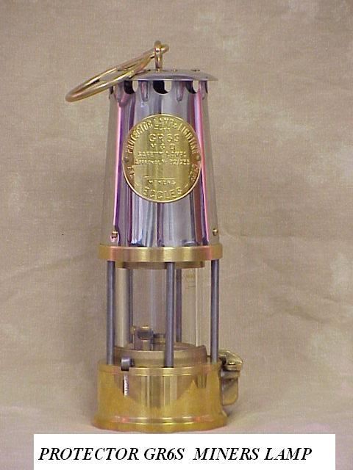
Accepted Significant matters
The Deputy was equipped with a flame safety lamp for gas detection.
The Undermanager, who arrived in the panel at a late stage, had both a flame safety lamp and a methanometer.
The Deputy’s flame safety lamp, which was damaged in the explosion, was shown by later examination to have some defects. In particular it was found that the relighter key was missing.

Slide 14
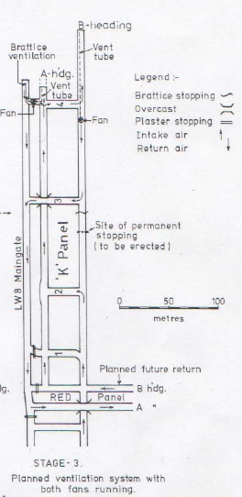
Body of deputy and his LOFSL found in S/Car

Slide 15
Accepted Significant matters
There was a brattice stopping in C/T 3, which should have been removed to allow flow of air into the return, it was not removed as expected and the time of its removal could not be determined.
The roadway in which the fan had been installed was almost completely unventilated for an undetermined period but possibly as long as five hours.
Scientific investigation indicated that the explosion was initiated at the face end of the standing stub entry. It was considered that flame had travelled up the vent tubes leading to the gas accumulation at the face.

Slide 16
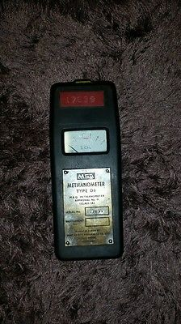
Gas control
There were three levels of methane covered by legislation in New South Wales at that time:
a level of 0.25 per cent in the intake,
a level of 1.25 per cent when electric power would be disconnected and
a level of 2.5 percent when workers would be withdrawn.
In addition it is important to acknowledge that methane in air will burn on a flame and can be recognized between 1.25 percent and 4.5 per cent with a LOFSL.
At 5 per cent an ignition occurs. When present at higher percentages methane is most easily ignited at 7.5 percent and has its maximum explosive strength at 9.8 percent.

Slide 17
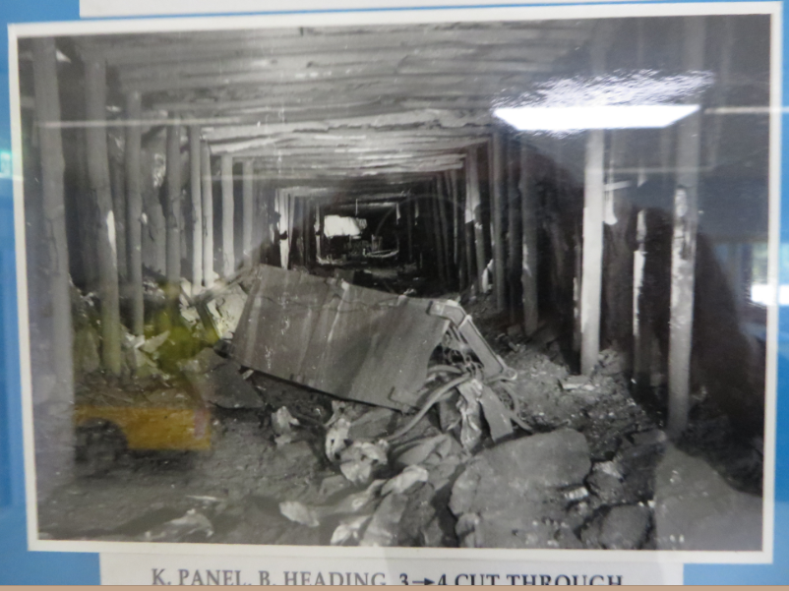
Gas control
There was not enforcement of the requirement, that intake gas levels should not exceed 0.25 per cent.
The auxillary fan was blown approx. 25m outbye by the force

Slide 18
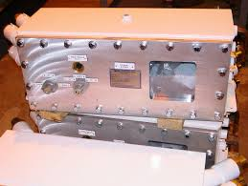
Flameproof enclosures
A flameproof enclosure is designed so that the lid of the enclosure fits on a wide edge that absorbs heat and prevents an internal explosion being transmitted with sufficient energy to ignite an external explosive mixture.
It is essential that the lid is tightly held in place –usually by a number of screwed studs.
If a flameproof enclosure is to be opened it is vitally important to disconnect the power supply
After the explosion at Appin the fan starter-box was found to be in a non-flameproof condition with only one of the 24 studs in place.
The starter-box immediately became suspect as the source of the ignition.

Slide 19
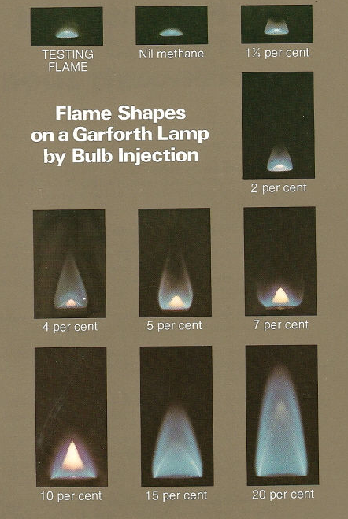
Flame safety lamps
Apart from the ability to show the presence of methane, safety lamps have also been regarded as being an important tool in providing warning by being extinguished in low levels of oxygen.
They have the characteristic that when they are placed in contact with methane at 5 per cent an ignition inside the lamp extinguishes the flame and the flame does not pass outside because of the protective gauze construction.

Slide 20
Flame safety lamps
A post-explosion investigation showed that many safety lamps at Appin and in the Illawarra, had minor defects.
A series of tests of safety lamps with these defects indicated that in some circumstances they could transmit an ignition to an outside explosive mixture.
The safety lamps issued to Deputies and other officials at Appin were of the Protector type with a pyrophor relighting facility.
The approval for that type of safety lamp contained a condition that a lamp should not be relit in a place where gas was likely to be present.

Slide 21
Removal of accumulations
The use of a fan to remove an accumulation of gas from a roadway is not an unusual event.
The essential features of such use are:
The area around the fan should not contain more than 1.25 per cent of methane.
The exhaust gas passing through the fan should contain less than 2.5 per cent methane. ( Now must be less than 1.25%)

Slide 22
Removal of accumulations
It would be the duty of the deputy to ensure the area was free of gas and to arrange for the vent tubes to be separated at a convenient point so that enough fresh air entered the tubes to ensure the exhaust was kept below 2.5 per cent.
The vent tubes inbye of the separation point carry high levels of methane and these are diluted by fresh air feeding in.
When the fan stops the methane-rich flow will not stop immediately.

Slide 23
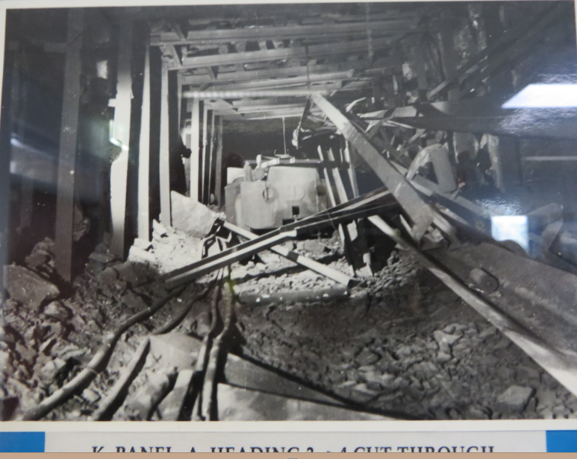
Blast pattern
After extensive testing at Londonderry and elsewhere it was agreed that the blast pattern in the starter box could only have been formed by an internal ignition.
Even though the cover was only held in place by one stud the explosion in B stub could not have caused the pattern in the box.

Slide 24
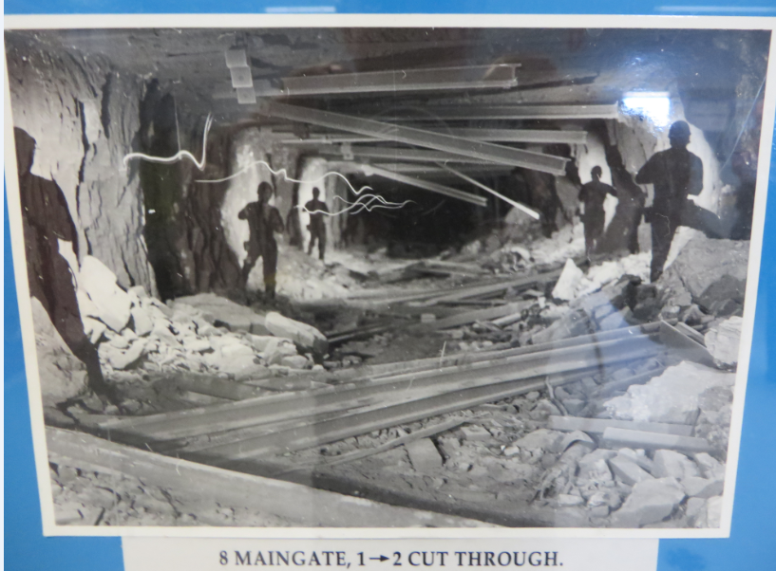

Slide 25
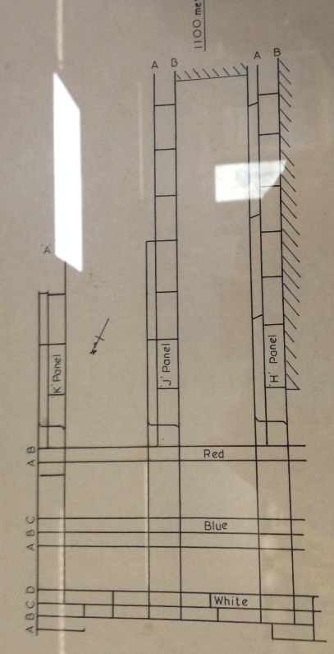
It was accepted that the trigger for the explosion was an ignition of methane that travelled inside the vent tubes.

Slide 26
If the starter box provided the spark for the ignition then, apart from the fact that power was left on to the fan, the following events must have occurred:
The flow of air in B heading was insufficient to prevent recirculation (possibly even when the fan was running in reverse and passing a low flow volume).
The recirculation was undetected.
An explosive mixture was allowed to pass through the fan perhaps because the vent tubes had not been separated

Slide 27
The cloud of recirculated air remained stationery around the fan and the starter box during the time taken to open the starter box.
Both the Deputy and the Undermanager, who were equipped with safety lamps, must have failed to notice or failed to act on the fact that their safety lamps were extinguished by the presence of the explosive mixture.
The starter button must have been pressed while the fan was not in a flameproof condition.

Slide 28
Alternative possibility
Supported by the fact that B heading was left virtually unventilated for an extended interval. During the period before the C/T 3 brattice was removed gas continued to accumulate. The build-up may well have extended into the zone between C/T 3 and C/T 4 and also into the starter box.
Under that condition the first application of power, that is when the fan was run in reverse, would have led to ignition in the box and could have led to formation of the blast pattern at a time when the box was in a flameproof condition

Slide 29
Alternative possibility
After the explosion the body of the Deputy was found in the shuttle car.
There is no logical reason for him to be there unless he was either on the boom of the miner or in the shuttle car controlling the gap in the vent tubes and ensuring that the fan exhaust was carrying a low percentage of methane.

Slide 30
Alternative possibility
It is possible that he did not realise he was in a spill of methane from the separated vent tubes and caused the ignition by attempting to relight his lamp.
Withdrawal of the key can cause a spark sufficient to ignite methane in the lamp. This proposition is reinforced by the fact that the Deputy’s lamp was found without the relighter key.
It is difficult to imagine how the force of an explosion could remove the key from a lamp if the key was fully home.

Slide 32
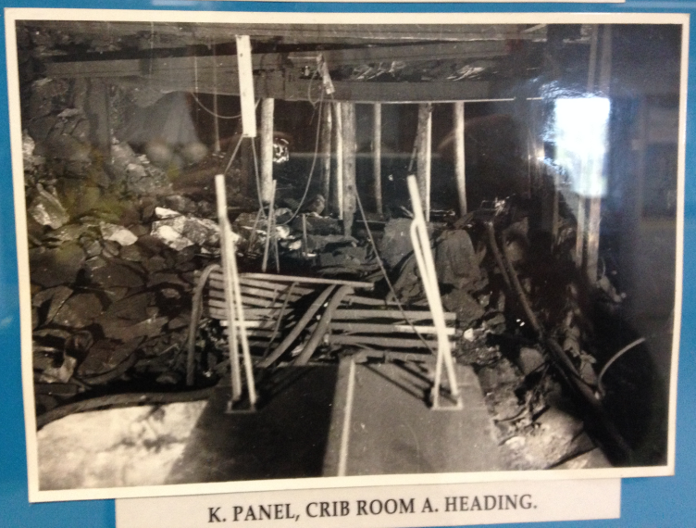

Slide 34
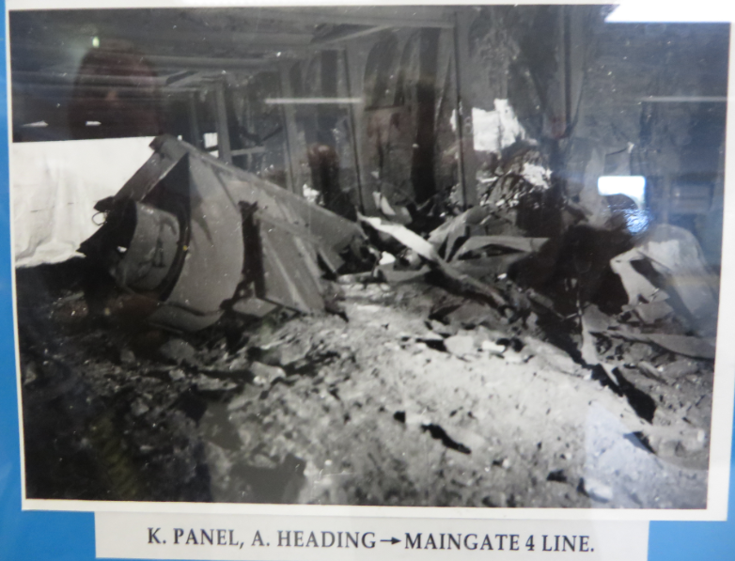
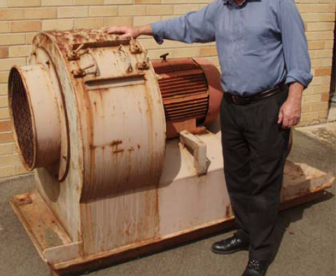
Fans in use at that time were only 9m3/S capacity

Slide 36
Steel W Strap

Slide 37
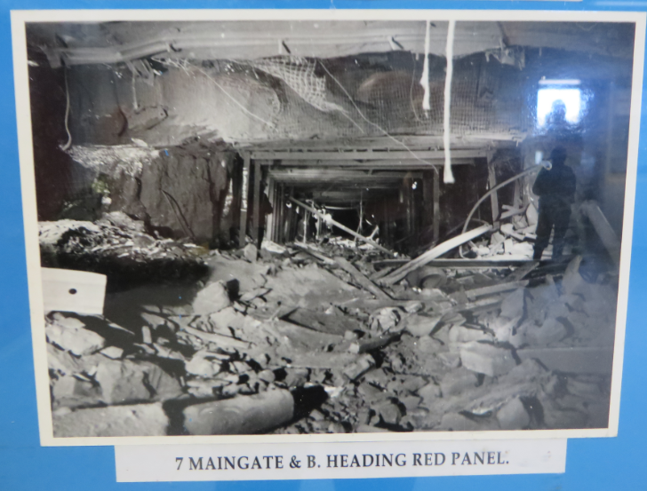
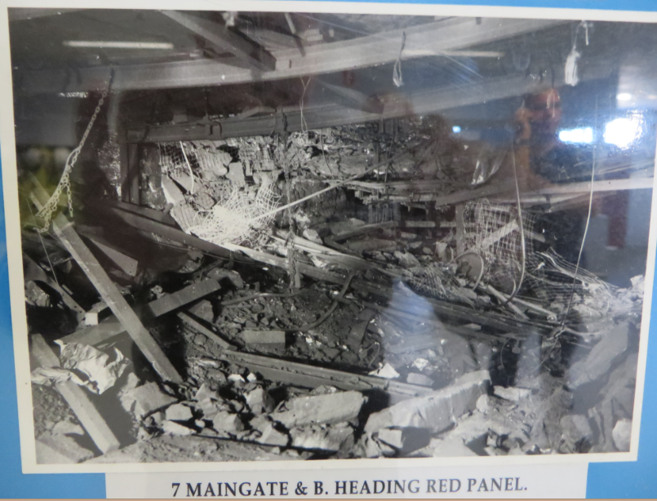

Slide 39
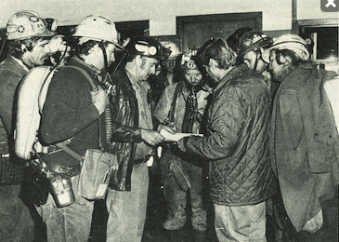
Lessons for Mining Officials
Following the Explosion an extensive public investigation /court of inquiry was held with a 180 page report
Some people were praised for their actions in particular the deputy from white panel and the longwall deputy in safely evacuating their men and the treatment of an electrical engineer who was burnt from the effects of the explosion
The actions of the rescue teams were also highly praised

Slide 40
Lessons for Mining Officials
However others were criticised in the report
It is vitally important you do your job properly and take proper action to rectify problems and also reports must be accurate and provide detail
You do not want to put yourself in a position where firstly you put yourself & others at risk and further more you may be criticised in public
Integrity and honesty are as important if not more important than the technical skills
If you are unsure of something – ask for help

Slide 41
Recommendations from enquiry
The Department should by inspections and advising collieries on new techniques assist deep mines with managing their gas problems.
Extensive gas Drainage systems and gas monitoring is now undertaken at all gassy mines
Recommended the appointment of ventilation officers to supervise ventilation at the mine.
All mines have statutory appointed Ventilation officers who model all major ventilation changes and supervise these ventilation changes

Slide 42
Recommendations from enquiry
Methane gas is largely allowed to be vented and wasted, whereas its entrapment and use may well go part of the way to meeting the cost of new measures to combat methane problems at mines.
Vented Methane is now used for power generation at some mines

Slide 43
Recommendations from enquiry
Deputies at Appin appeared to allow substantial quantities of Methane gas to collect in standing places on the basis that there is no danger if there is no ignition source
This is a dangerous practice & leads to complacency
It was permitted to continue by tolerance of Gas levels above statutory limits including at the commencement of the Hazardous zone
As a result of the Appin Explosion the strictest controls of Intake Methane percentages should be maintained

Slide 44
Recommendations from enquiry
The Deputies Statutory reports, at the time called GR4, were vague and gave no real indication as to the actual gas concentration or ventilation – space was only available for minimum reporting.
Deputies Statutory reports now provide more room for more detailed reporting and that is what is required particularly gas levels, location and times
Time | 8.00am | 10.00am | 12.00 | 2.00 pm | 4.00 pm
CH4 | 0.4% | 0.45% | 0.5% | 0.55% | 0.6%
CO2 | 0.8% | 0.84% | 0.83% | 0.8% | 0.81%

Slide 45
Recommendations from enquiry
There should be a check upon deputies safety inspections
Suggested this should be done by check inspectors
Raised the suggestion of an Individual check inspector for each mine – this is now in place

Slide 46
Recommendations from enquiry
The deputies must be given methanometers in addition to the lamp so they can measure CH4 between zero and 1.25%
Appin mine has already instigated this prior to the Goran report
Hand held Gas are now available to monitor multiple gases with preset high and low audible and visual alarms

Slide 47
Recommendations from enquiry
After a Ventilation Change power should be Isolated and production cease.
A period of waiting and testing with any degassing should occur before production recommences

Slide 48
Recommendations from enquiry
There appears to be a totally inadequate number of Electrical Inspectors
There seems to be inspections separated by months and they do not involve the whole of the mine.
No record of Inspectors Inspections seems to be left at the mine
Copies of exemptions given to management should also be given to Check Inspectors

Slide 49
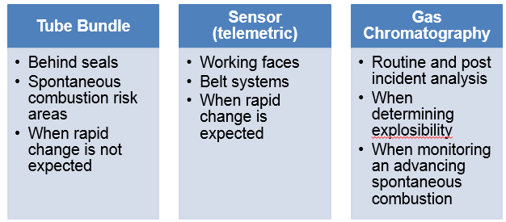
Recommendations from enquiry
In Gassy mines there need to be requirements that an automatic monitoring device of a portable nature be installed at strategic points in headings to give a continuous reading of CH4,CO & O2
An added advantage would be alarm Levels

Slide 50
Recommendations from enquiry
Tradesman and workers who work alone should be equipped with an automatic monitoring and warning device with an audible and visual alarm
There is a grave danger in driving stubs in gassy mines and leaving standing on brattice particularly on the intake side
No dead end should exceed a pre determined length before being required to be ventilated by auxiliary fan.
A suggested distance of 50m is put forward as the limit

Slide 51
Recommendations from enquiry
Recommended that the regulations make provision for not removing any Barrier once placed in position.
The practice at Appin was to remove O/bye barriers once a development had reached a point considered sufficiently far removed inbye.
There was evidence that an o/bye barrier in L/wall 7 Main gate did much to check the explosion and so avoid complete disaster

Slide 53
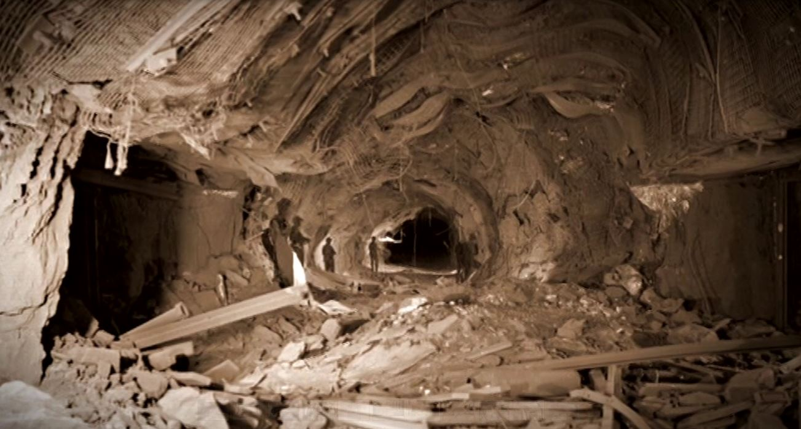

Slide 54
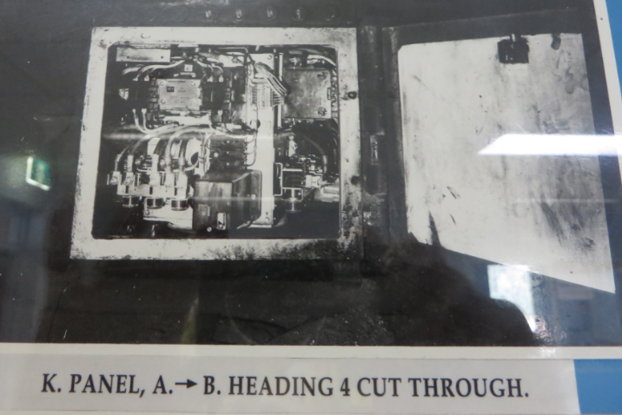
Recommendations from enquiry
There needs to be proper policing of the Act & Regulations which deal with the opening of flameproof enclosures under voltage and the removing of power to machines and cables where prescribed limits of Methane gas has been detected
Unapproved mods to electrical equipment indicated little regard for departmental requirements

Slide 55
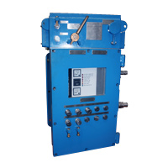
Recommendations from enquiry
Regulation by legislation is required for a breaker system to prevent any flameproof enclosure being opened without the automatic disconnection of power.
There is also a grave necessity for an interlocking circuit which will automatically trip the power to the miner if the auxiliary fan stops and even better would be the cutting of power to the section

Slide 56
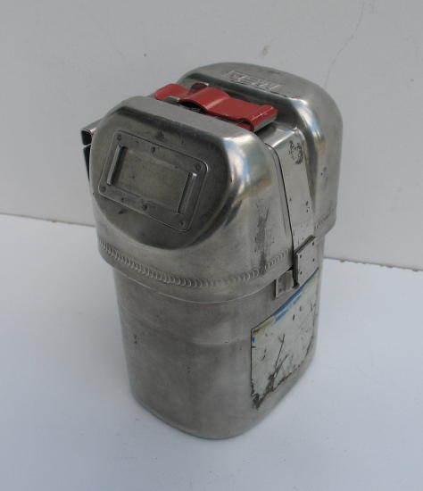
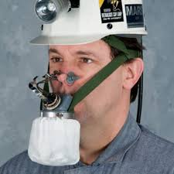
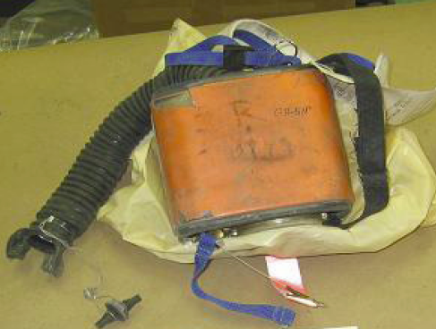
Recommendations from enquiry
Investigation should be undertaken to find a more effective Self rescuer without the discomfort and heat felt by the workmen who escaped at Appin mine
Men should be taught what to expect when wearing a self rescuer

Slide 57
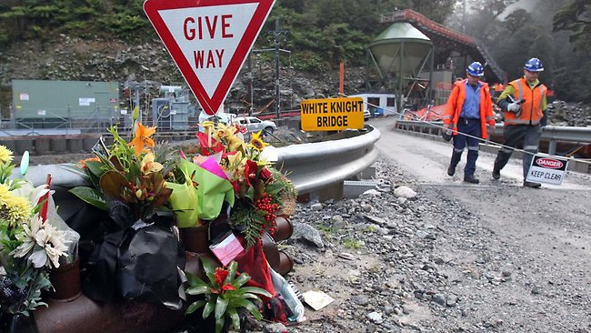
Today...
Auxiliary fans have degassing / Dilution chambers and 2 Methane monitors, one situated inside the ducting and one at the rear of the fan for general body set to trip at 1.25% CH4
Mining supervisors carry methane detectors which can detect multiple gases, Eg CH4,CO2,O2,CO, H2s and have low and high level alarms and can record peak readings
There is so much in place to reduce the risk of a methane explosion and so many other hazards however if people do not fully understand the risk and why controls are in place there very well could be another disaster

Slide 58
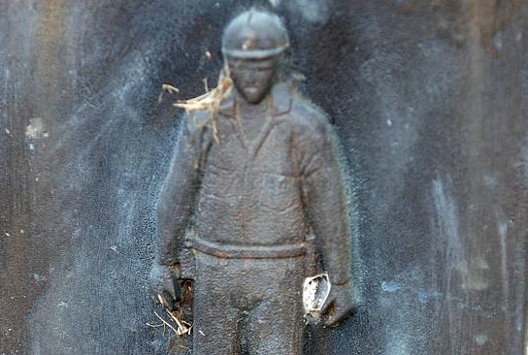
This Presentation is a tribute to these miners and as an initiative to educate young people in the industry so it never happens again
Alwyn Brewin,
Francis Garrity,
Ian Giffard,
Geoffrey Johnson,
Jurgen Lauterbach,
Alexander Lawson,
James Oldcorn,
Peter Peck,
Robert Rawcliffe,
Roy Rawlings,
Karl Staats,
John Stoneham ,
Roy Williams
Garry Woods

